Slide 1
SECURE DATA HIDING IN IMAGES USING STENOGRAPHY
CAPSTONE PROJECT
Presented By: KONDURU RAKESH
Student Name : KONDURU RAKESH
College Name & Department : Prince shri Venkateswara padmavathy engineering collage & CSE

Slide 2
OUTLINE
Problem Statement
Technology used
Wow factor
End users
Result
Conclusion
Git-hub Link
Future scope

Slide 3
Problem Statement
Traditional encryption methods attract attention, making data vulnerable to attacks. Steganography hides information in images, but existing techniques struggle with low capacity and detection risks. This project enhances Least Significant Bit (LSB) embedding for better security and imperceptibility. The goal is to develop a robust, high-capacity, and stealthy data-hiding solution for secure communication.

Slide 4
Technology used
Libraries & Platforms:
Programming Language: Python
Platform: Python
Library: OpenCV (cv2) – For image processing and manipulation
Additional: NumPy – For handling pixel arrays efficiently
Optional: os – For file handling and automation tasks

Slide 5
Wow factors
High Imperceptibility: Uses optimized LSB steganography to hide data without visible distortion.
Custom OpenCV Implementation: No external libraries, ensuring full control over image processing.
Enhanced Security: Can integrate bitwise operations or encryption for added protection.
Scalability: Supports hiding data in grayscale or color images with adjustable capacity.
Steganalysis Resistance: Potential to add noise reduction or random pixel embedding to evade detection.

Slide 6
End users
Cybersecurity Professionals – For secure communication and data protection.
Government & Defense – To transmit classified information covertly.
Journalists & Activists – For secure message exchange in restricted environments.
Forensic Experts – To hide and recover crucial evidence securely.
General Users – Anyone needing confidential data storage within images.

Slide 7
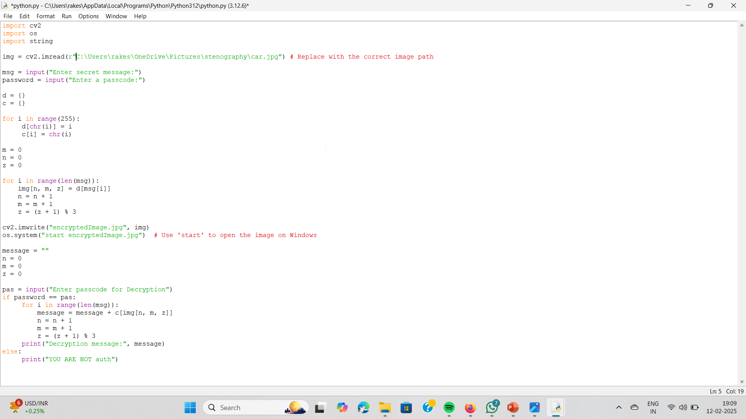
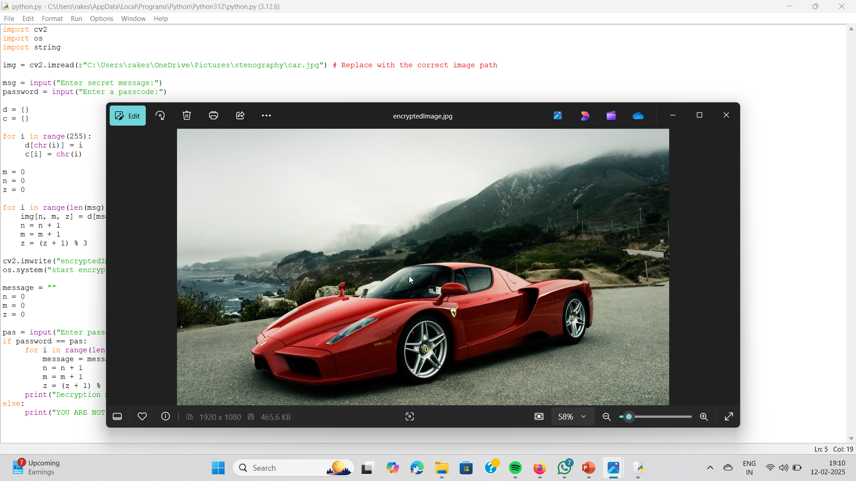
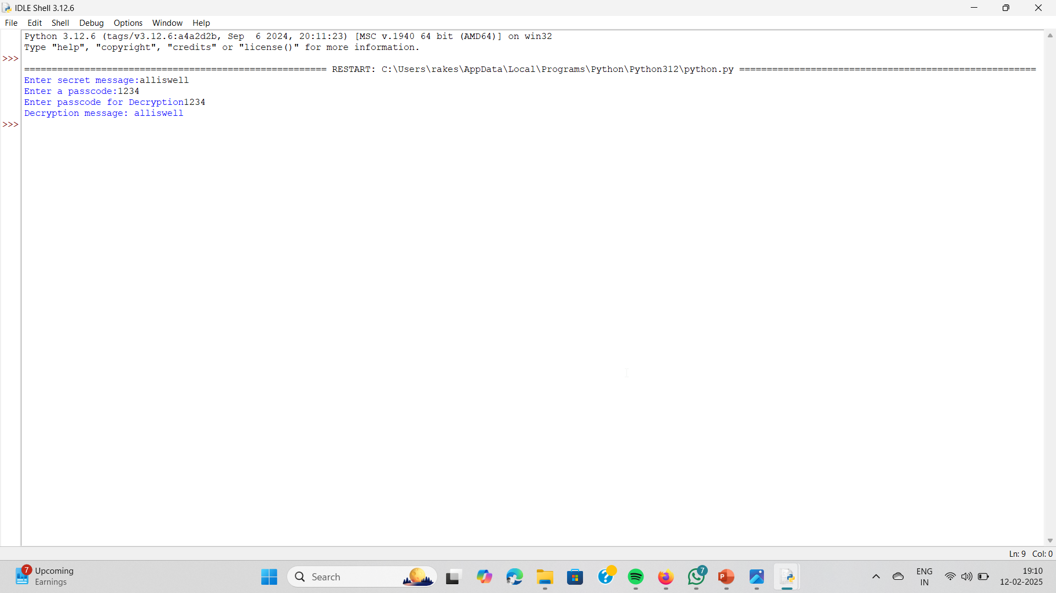
Results

Slide 8
Conclusion
This project demonstrates a secure and efficient image steganography technique using OpenCV, ensuring covert data transmission. By leveraging LSB-based embedding, it maintains high imperceptibility while maximizing data capacity. The custom implementation provides full control and flexibility, making it suitable for secure communication. With potential enhancements like encryption and steganalysis resistance, this method offers a robust solution for data hiding in various real-world applications.

Slide 9
GitHub Link
https://github.com/Rakire/Steganography-.git

Slide 10
Future scope(optional)
Enhanced Security: Integrate encryption techniques before embedding data for stronger protection
.Adaptive Steganography: Develop AI-powered methods to dynamically adjust embedding for better imperceptibility.
Resistance to Steganalysis: Implement noise reduction or random pixel selection to evade detection algorithms.
Higher Capacity Techniques: Explore DCT (Discrete Cosine Transform) or DWT (Discrete Wavelet Transform) for improved data hiding.

Slide 11
THANK YOU

